Slide 1
LOA1 Object Name
skull
r_upperarm
l_upperarm
r_forearm
l_forearm
l5
pelvis
r_thigh
l_thigh
r_carpal
l_carpal
sacrum
r_calf
l_calf
r_talus
l_talus
r_tarsal_proximal_phalanx
l_tarsal_proximal_phalanx

Slide 2
LOA2 Object Name
skull
r_clavicle
c2
l_clavicle
r_scapula
c4
l_scapula
r_upperarm
t1
l_upperarm
t6
t10
l1
r_forearm
l3
l_forearm
l5
pelvis
r_thigh
l_thigh
r_carpal
l_carpal
r_metacarpal_[1,2,3,4,5]
sacrum
l_metacarpal_[1,2,3,4,5]
r_carpal_proximal_phalanx_[1,2,3,4,5]
l_carpal_proximal_phalanx_[1,2,3,4,5]
r_carpal_middle_phalanx_[2,3,4,5]
l_carpal_middle_phalanx_[2,3,4,5]
r_carpal_distal_phalanx_[2,3,4,5]
l_carpal_distal_phalanx_[2,3,4,5]
r_carpal_distal_phalanx_[1]
l_carpal_distal_phalanx_[1]
r_calf
l_calf
r_talus
l_talus
r_metatarsal
l_metatarsal
r_tarsal_proximal_phalanx
l_tarsal_proximal_phalanx
r_tarsal_distal_phalanx
l_tarsal_distal_phalanx

Slide 3
r_eyebrow
l_eyebrow
LOA3 Object Name
r_eyelid
l_eyelid
r_eyeball
l_eyeball
jaw
skull
c5
c1
r_clavicle
c6
c2
l_clavicle
c7
c3
r_scapula
c4
l_scapula
r_upperarm
t2
t1
l_upperarm
t4
t3
t6
t5
t8
t7
t10
t9
t12
t11
l2
l1
r_forearm
l3
l_forearm
l4
l5
pelvis
r_thigh
l_thigh
r_carpal
l_carpal
r_metacarpal_[1,2,3,4,5]
sacrum
l_metacarpal_[1,2,3,4,5]
r_carpal_proximal_phalanx_[1,2,3,4,5]
l_carpal_proximal_phalanx_[1,2,3,4,5]
r_carpal_middle_phalanx_[2,3,4,5]
l_carpal_middle_phalanx_[2,3,4,5]
r_carpal_distal_phalanx_[2,3,4,5]
l_carpal_distal_phalanx_[2,3,4,5]
r_carpal_distal_phalanx_[1]
l_carpal_distal_phalanx_[1]
r_calf
l_calf
r_talus
l_talus
r_metatarsal
l_metatarsal
r_tarsal_proximal_phalanx
l_tarsal_proximal_phalanx
r_tarsal_distal_phalanx
l_tarsal_distal_phalanx

Slide 4
r_eyebrow
l_eyebrow
LOA4 Object Name
r_eyelid
l_eyelid
r_eyeball
l_eyeball
jaw
skull
c5
c1
r_clavicle
c6
c2
l_clavicle
c7
c3
r_scapula
c4
l_scapula
r_upperarm
t2
t1
l_upperarm
t4
t3
t6
t5
t8
t7
t10
t9
t12
t11
l2
l1
r_forearm
l3
l_forearm
l4
l5
pelvis
r_thigh
l_thigh
r_carpal
l_carpal
r_trapezium / r_trapezoid / r_capitate / r_hamate
sacrum
l_trapezium / l_trapezoid / l_capitate / l_hamate
r_metacarpal_[1,2,3,4,5]
l_metacarpal_[1,2,3,4,5]
r_carpal_proximal_phalanx_[1,2,3,4,5]
l_carpal_proximal_phalanx_[1,2,3,4,5]
r_carpal_middle_phalanx_[2,3,4,5]
l_carpal_middle_phalanx_[2,3,4,5]
r_carpal_distal_phalanx_[2,3,4,5]
l_carpal_distal_phalanx_[2,3,4,5]
r_carpal_distal_phalanx_[1]
l_carpal_distal_phalanx_[1]
r_calf
l_calf
r_talus
l_talus
r_calcaneus
l_calcaneus
r_navicular
l_navicular
r_cuneiform_[1,2,3] / r_cuboid
l_cuneiform_[1,2,3] / l_cuboid
r_metatarsal_[1,2,3,4,5]
l_metatarsal_[1,2,3,4,5]
r_tarsal_proximal_phalanx_[1,2,3,4,5]
l_tarsal_proximal_phalanx_[1,2,3,4,5]
r_tarsal_middle_phalanx_[2,3,4,5]
l_tarsal_middle_phalanx_[2,3,4,5]
r_tarsal_distal_phalanx_[2,3,4,5]
r/l_tarsal_distal_phalanx__[1]
l_tarsal_distal_phalanx_[2,3,4,5]

Slide 5
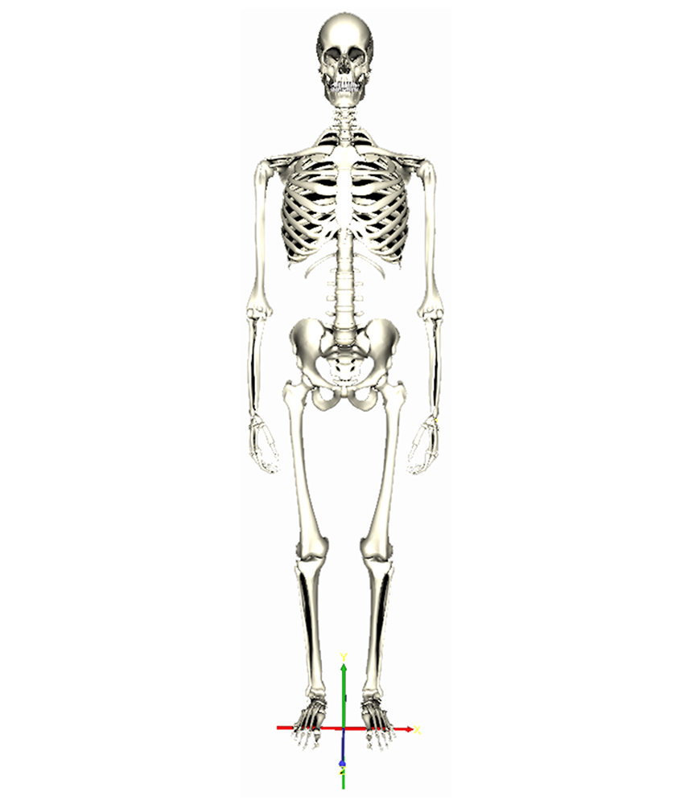
LOA-0
HumanoidRoot

Slide 6
LOA1 JOINT
skullbase
r_shoulder
l_shoulder
r_elbow
l_elbow
vl5
sacroiliac
r_hip
l_hip
r_radiocarpal
l_radiocarpal
HumanoidRoot
r_knee
l_knee
r_talocrural
l_talocrural
r_metatarsophalangeal
l_metatarsophalangeal

Slide 7
LOA-2
skullbase
r_sternoclavicular
vc2
l_sternoclavicular
vc4
r_acromioclavicular
l_acromioclavicular
r_shoulder
l_shoulder
vt6
vt1
vt10
vl1
r_elbow
vl3
l_elbow
vl5
sacroiliac
r_hip
l_hip
r_radiocarpal
l_radiocarpal
r_carpometacarpal_[1,2,3,4,5]
HumanoidRoot
l_carpometacarpal_[1,2,3,4,5]
r_metacarpophalangeal_[1,2,3,4,5]
l_metacarpophalangeal_[1,2,3,4,5]
r_carpal_proximal_interphalangeal_[2,3,4,5]
l_carpal_proximal_interphalangeal_[2,3,4,5]
r_carpal_distal_interphalangeal_[2,3,4,5]
l_carpal_distal_interphalangeal_[2,3,4,5]
r_carpal_interphalangeal_[1]
l_carpal_interphalangeal_[1]
r_knee
l_knee
r_talocrural
l_talocrural
r_tarsometatarsal
l_tarsometatarsal
r_metatarsophalangeal
l_metatarsophalangeal
r_tarsar_interphalangeal
l_tarsal_interphalangeal

Slide 8
r_eyebrow
l_eyebrow
LOA-3
r_eyelid
l_eyelid
r_eyeball
l_eyeball
temporomandibular
skullbase
vc5
vc1
r_sternoclavicular
vc2
l_sternoclavicular
vc6
vc3
vc7
vc4
r_acromioclavicular
l_acromioclavicular
r_shoulder
vt2
vt1
l_shoulder
vt4
vt3
vt6
vt5
vt8
vt7
vt10
vt9
vt12
vt11
vl2
vl1
r_elbow
vl3
l_elbow
vl4
vl5
sacroiliac
r_hip
l_hip
r_radiocarpal
l_radiocarpal
r_carpometacarpal_[1,2,3,4,5]
HumanoidRoot
l_carpometacarpal_[1,2,3,4,5]
r_metacarpophalangeal_[1,2,3,4,5]
l_metacarpophalangeal_[1,2,3,4,5]
r_carpal_proximal_interphalangeal_[2,3,4,5]
l_carpal_proximal_interphalangeal_[2,3,4,5]
r_carpal_distal_interphalangeal_[2,3,4,5]
l_carpal_distal_interphalangeal_[2,3,4,5]
r_carpal_interphalangeal_[1]
l_carpal_interphalangeal_[1]
r_knee
l_knee
r_talocrural
l_talocrural
r_tarsometatarsal
l_tarsometatarsal
r_metatarsophalangeal
l_metatarsophalangeal
r_tarsar_interphalangeal
l_tarsal_interphalangeal

Slide 9
r_eyebrow
l_eyebrow
LOA-4
r_eyelid
l_eyelid
r_eyeball
l_eyeball
temporomandibular
skullbase
vc5
vc1
r_sternoclavicular
vc6
vc2
l_sternoclavicular
vc7
vc3
r_acromioclavicular
vc4
l_acromioclavicular
r_shoulder
vt2
vt1
l_shoulder
vt4
vt3
vt6
vt5
vt8
vt7
vt10
vt9
vt12
vt11
vl2
vl1
r_elbow
vl3
l_elbow
vl4
vl5
sacroiliac
r_hip
l_hip
r_radiocarpal
l_radiocarpal
r_midcarpal_[1,2,3,4_5]
HumanoidRoot
l_midcarpal_[1,2,3,4_5]
r_carpometacarpal_[1,2,3,4,5]
l_carpometacarpal_[1,2,3,4,5]
r_metacarpophalangeal_[1,2,3,4,5]
l_metacarpophalangeal_[1,2,3,4,5]
r_carpal_proximal_interphalangeal_[2,3,4,5]
l_carpal_proximal_interphalangeal_[2,3,4,5]
r_carpal_distal_interphalangeal_[2,3,4,5]
l_carpal_distal_interphalangeal_[2,3,4,5]
r_carpal_interphalangeal_[1]
l_carpal_interphalangeal_[1]
r_knee
l_knee
r_talocrural
l_talocrural
r_calcaneuscuboid
l_calcaneuscuboid
r_talocalcaneonavicular
l_talocalcaneonavicular
r_cuneonavicular_[1,2,3] / r_transversetarsal
l_cuneonavicular_[1,2,3] / l_transversetarsal
r_tarsometatarsal_[1,2,3,4,5]
l_tarsometatarsal_[1,2,3,4,5]
r_metatarsophalangeal_[1,2,3,4,5]
l_metatarsophalangeal_[1,2,3,4,5]
r_tarsal_proximal_interphalangeal_[2,3,4,5]
l_tarsal_proximal_interphalangeal_[2,3,4,5]
r_tarsal_distal_interphalangeal_[2,3,4,5]
r/l_tarsal_interphalangeal_1
l_tarsal_distal_interphalangeal_[2,3,4,5]

